Slide 1
Resourcing planning in an everchanging world
Have we reached crisis point?
Lindsey Richards Vice President RTPI

Slide 2
What creates a great place?
Who creates great places?
Context; planning in the 21st century
Public perception of planning
Misinformation and social media
Investment and funding planning
Planning career survey /recruitment and retention
Solutions

Slide 3
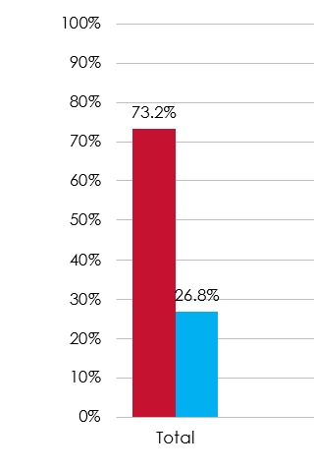
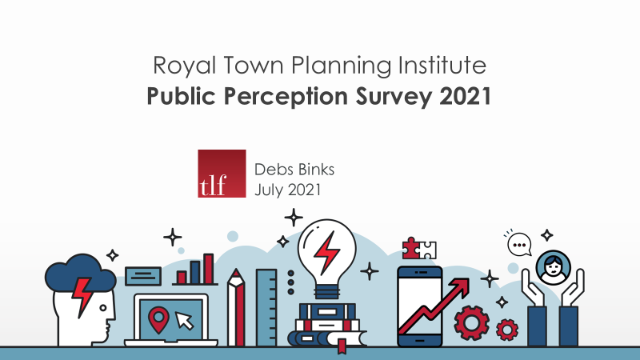
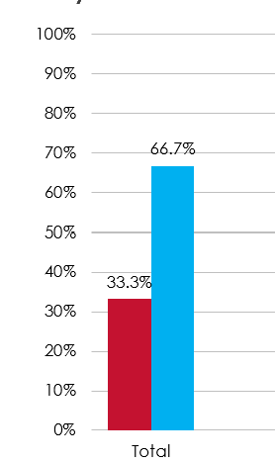
Public perception survey
Do you know what planners do?
Have you been in contact with planners?

Slide 4
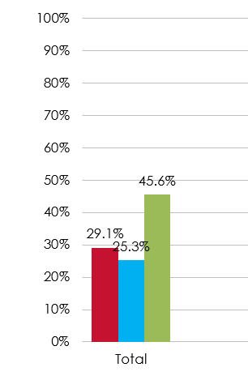
There is general uncertainty regarding whether or not the current planning system is fit for purpose.
“ A failing system “
“ Enemies of Enterprise”
“The system is clearly broken” they cry... is a car broken just because you’ve refused to put fuel into it?” 50 Shades of Planning
A need to raise awareness and understanding about the wider role of Town Planners and the benefits to the general public and their needs.

Slide 5
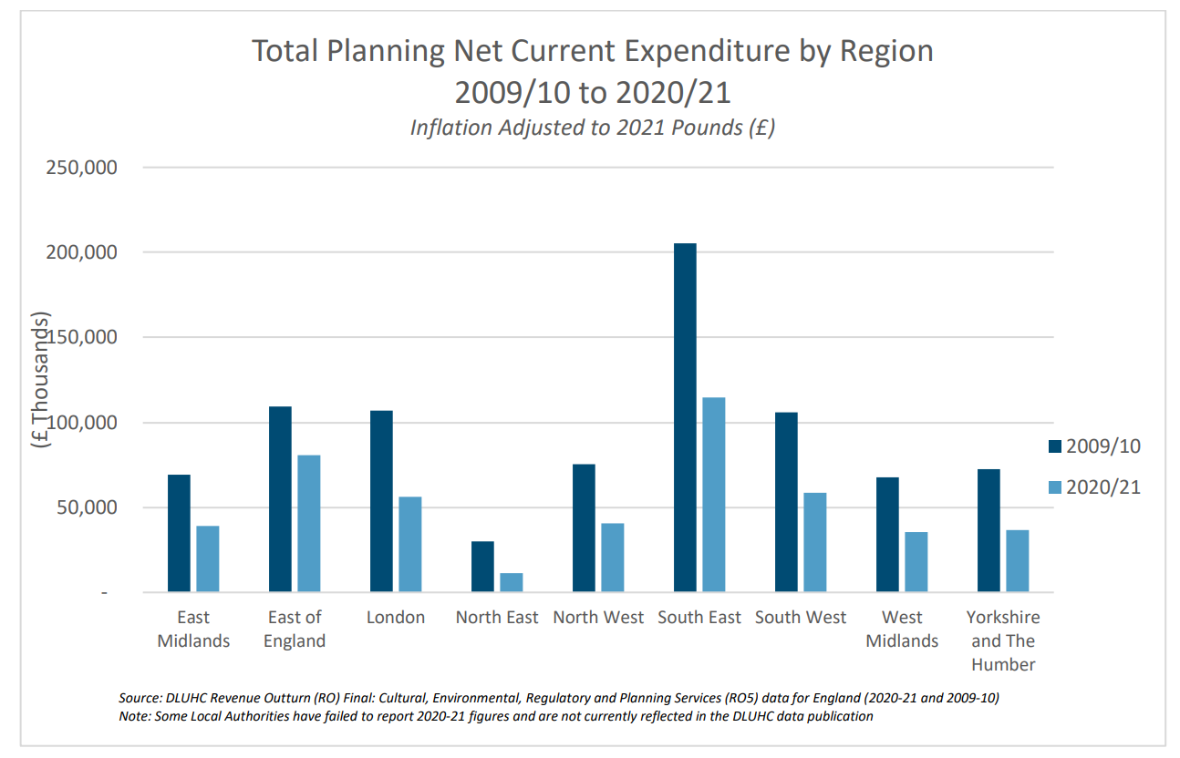
Investment and Funding
Significant budget cuts impacting recruitment and performance
Nationally, local authority net expenditure
on planning fell by 43%, from
£844m in 2009/10 to £480m in 2020/21, when adjusted to 2021 pounds. This amounts to just
0.45% of local government budgets allocated to planning services.

Slide 6
The Planner Careers Survey 2023
903 respondents (broadly statistically significant)
65% public Vs 35% private (73/27 last year)
Gender split in favour of women 58% to 41%
10% of respondents identified as BAME
Additional element in this year’s survey was well-being, welfare and impacts of social media – Presidential theme.

Slide 7
Career progress and resourcing
Are you happy with your salary progression?
62% public sector think they are underpaid for their responsibility (33% private sector)
55% public sector say salaries have not kept pace with inflation (39% private sector)
Majority of public and private are satisfied with career progression
74% of public sector do not feel their department has the resources it needs (21% in private sector)

Slide 8
Well-being and resourcing
Two thirds of respondents reported an increasing work-load over the past two years.
As many as 89% admitted to being over-stretched at some point
17% said all of the time and 8% said daily
58% cited recruitment as the biggest challenge
A further 48% said planning reforms were the biggest challenge
38% claimed introduction of BNG requirements was their biggest challenge

Slide 9
Planning and Misinformation
One of the standout findings from The Planner 2023 Careers Survey was that almost all planners feel social media fuels misinformation about planning.
87% of respondents felt social media regularly ( 54%) or occasionally ( 33%) contributed to misinformation about planning issues.
23% of respondents negatively targeted through social media
Inflammatory and aggressive public discourse appears endemic in the age of social media

Slide 10
Solutions
Whilst nearly 3 in 4 are aware of Town Planners per se, there is clearly scope to raise awareness and understanding about the wider role of Town Planners and the benefits to the general public and their needs.
Raise awareness of planning
Benefits and value of planning
Build the pipeline, grow the profession
Support wellbeing and welfare

Slide 11
RTPI support
What are the RTPI doing?
Presidential priorities
Launched a welfare helpline for members
Launched a regional pilot on conflict resolution
Value of a long-term campaign
Engaging with other institutes
Apprenticeships
Bursaries

Slide 12
Lindsey Richards RTPI Vice President

