Slide 1
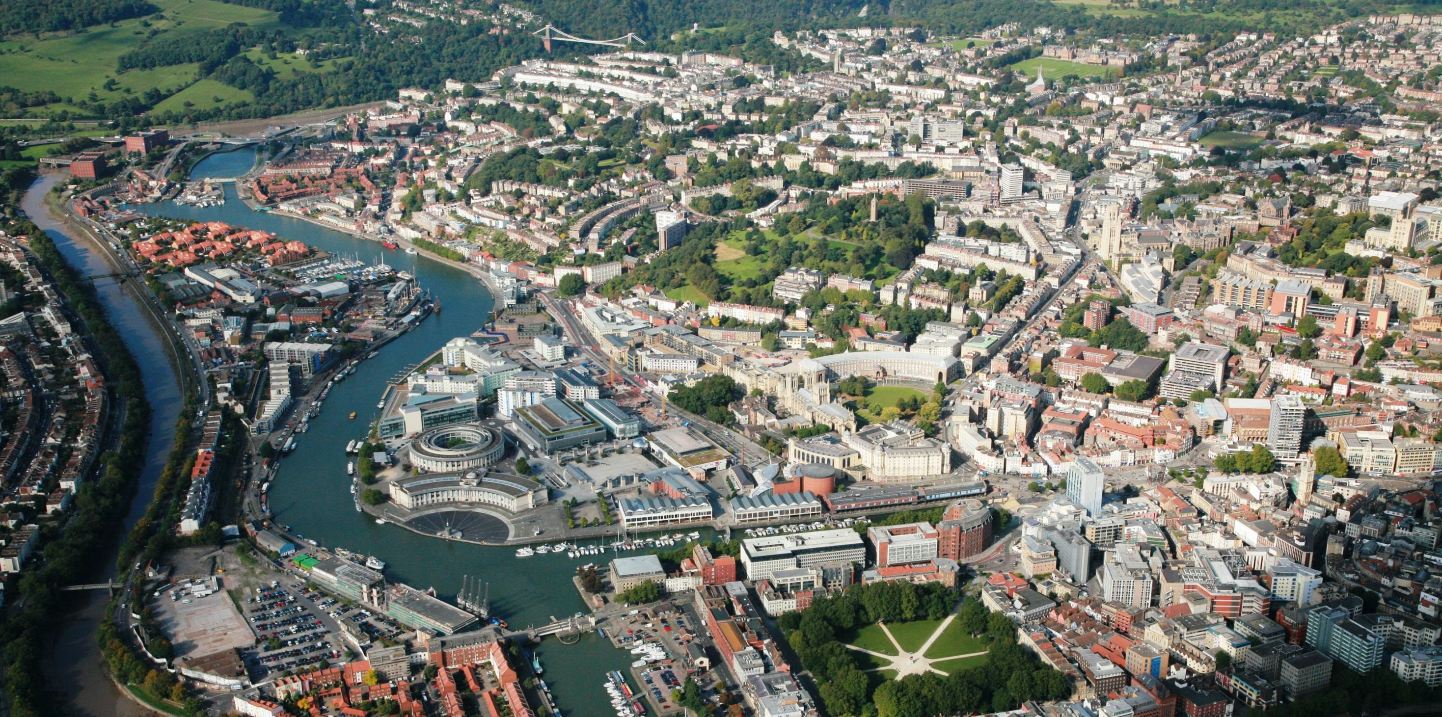
Inclusive and Sustainable Growth
John Smith Executive Director
Growth and Regeneration Bristol City Council

Slide 2
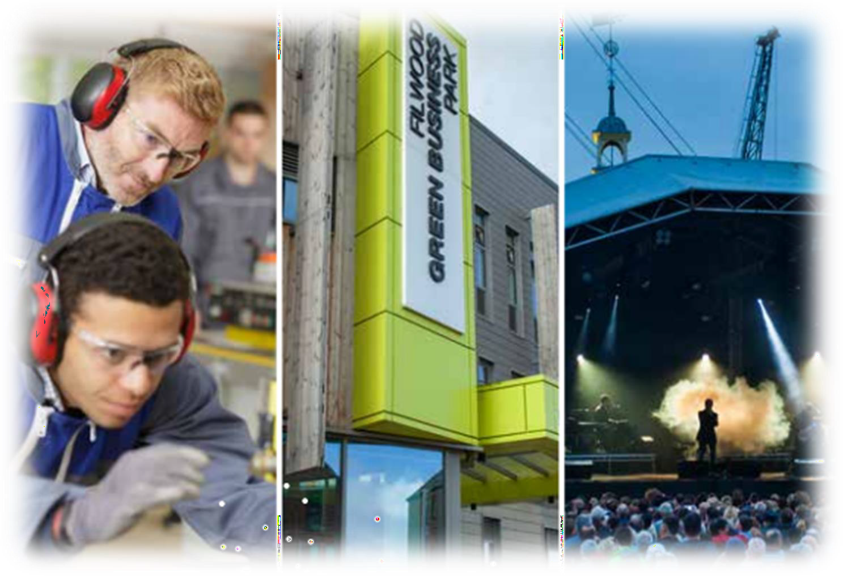
Bristol Economy
High employment rate
Higher than average earnings
Young and well-educated population
High value growth sectors
Resilient and dynamic SME base
£15bn GVA

Slide 3
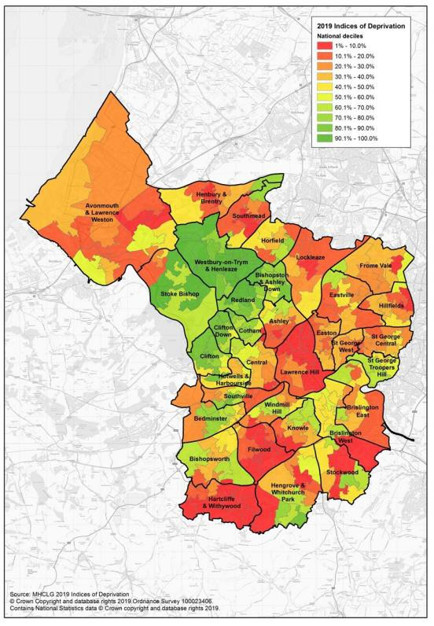
Challenges
Indices of Deprivation 2019 Bristol continues to have deprivation ‘hot spots’ that are amongst some of the most deprived areas in the country - adjacent to some of the least deprived areas in the country
Deprivation
Inequalities
Poverty
Low pay sectors
Precarious employment
Cost of living crisis
At ward level, the greatest levels of deprivation are in the wards of Hartcliffe & Withywood, Lawrence Hill and Filwood.

Slide 4
Challenges
15%
increase in population by 2043
Workforce to grow by 13% by
2040
Connectivity
Housing supply
Achieve net zero by 2030
Public services under pressure

Slide 5
Our Vision
One City Approach brings together a huge range of public, private, voluntary and third sector partners within Bristol
Our 2050 vision: Bristol is a fair healthy and sustainable city. A city of hope and aspiration where everyone can share in its success.
Our vision for place: development that ensures provision for future homes jobs and quality places, improves connectivity and the protection of green spaces and concentrates on areas with communities experiencing long term deprivation.

Slide 6
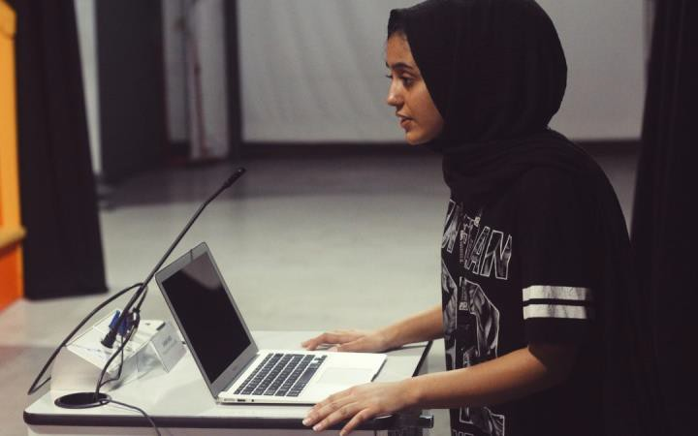
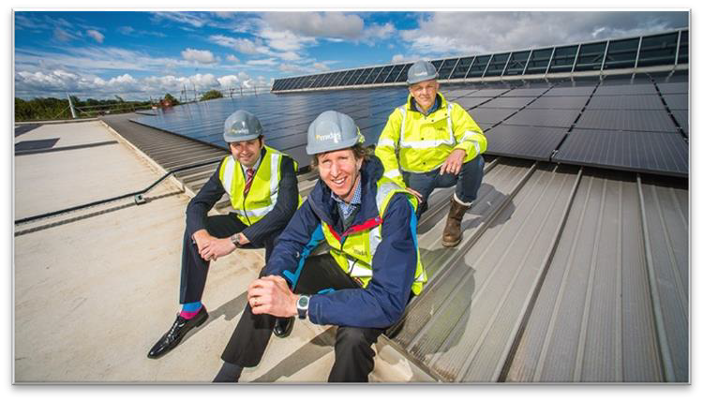
Inclusive and Sustainable Growth
Work with investors and organisations who share our values-led
approach
Work closely with partners who understand our ambitions and have expertise to enable us to achieve them
Embed our communities in our plans
Address identified need - be targeted and tailor support
Leverage social value
Be agile and respond to emerging need – cost of living crisis

Slide 7
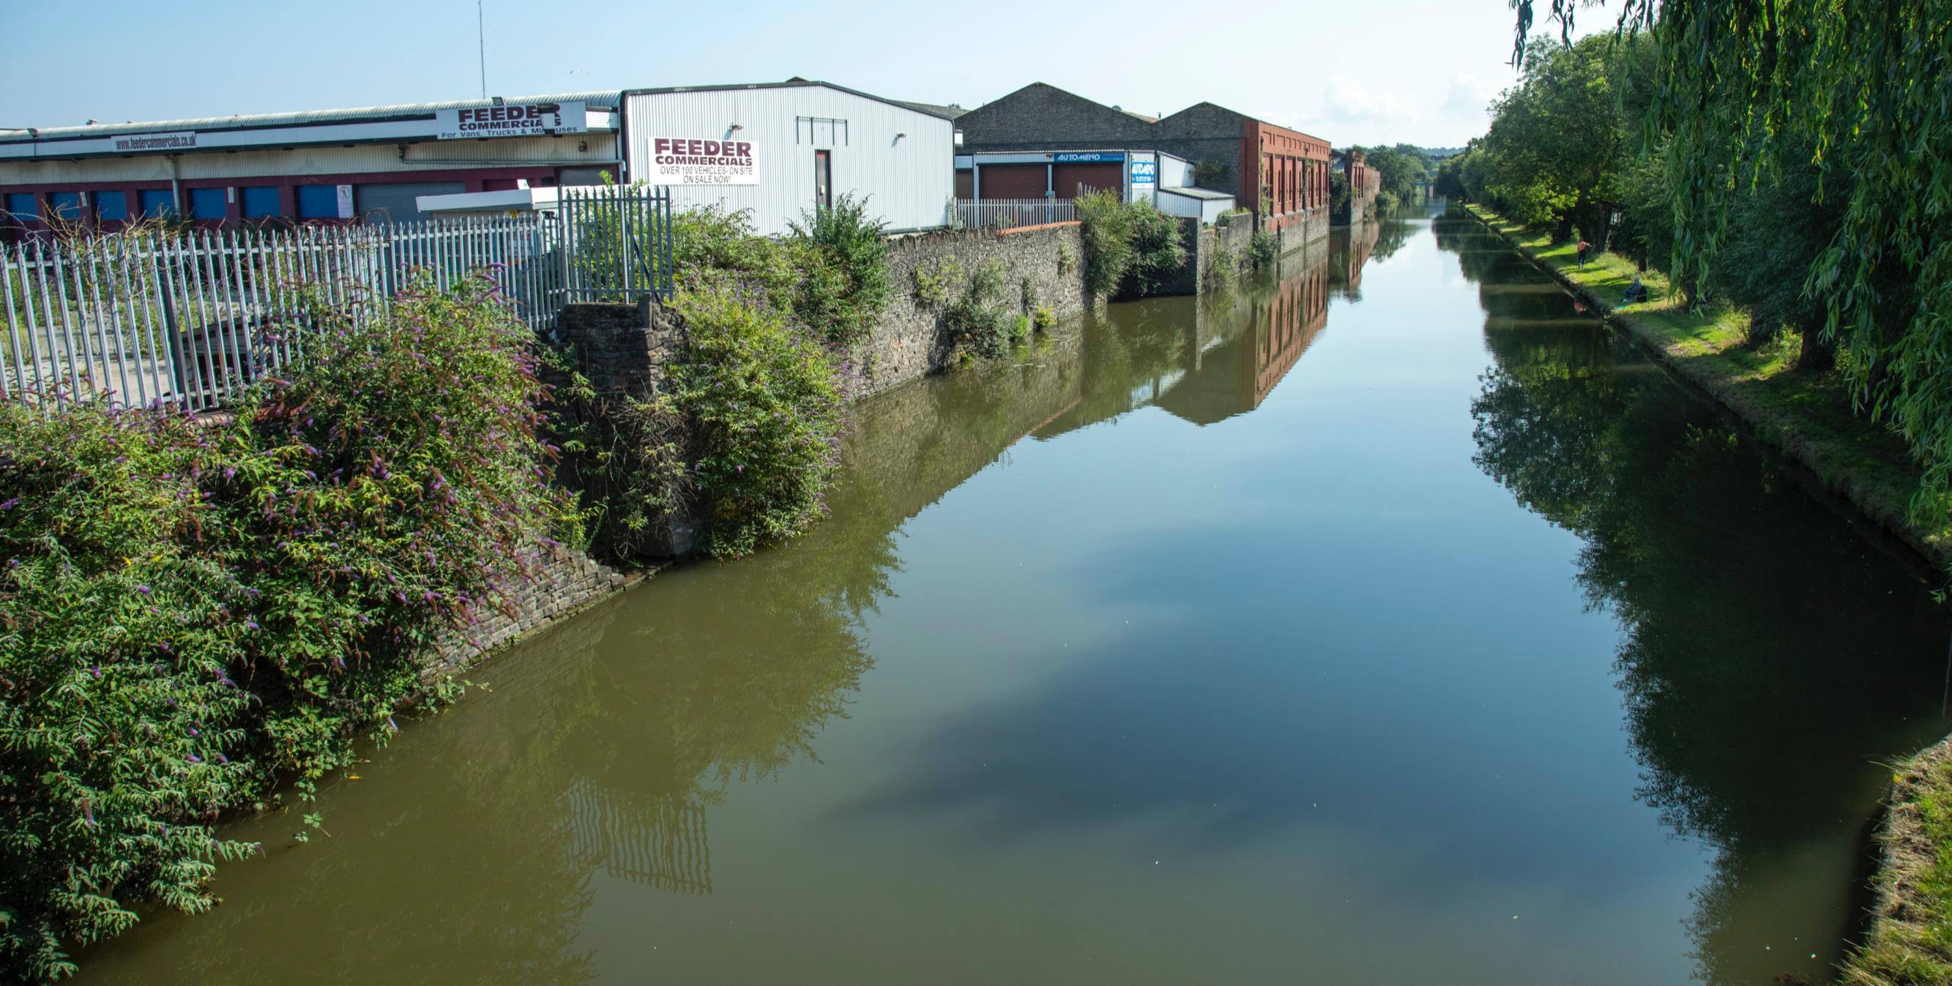
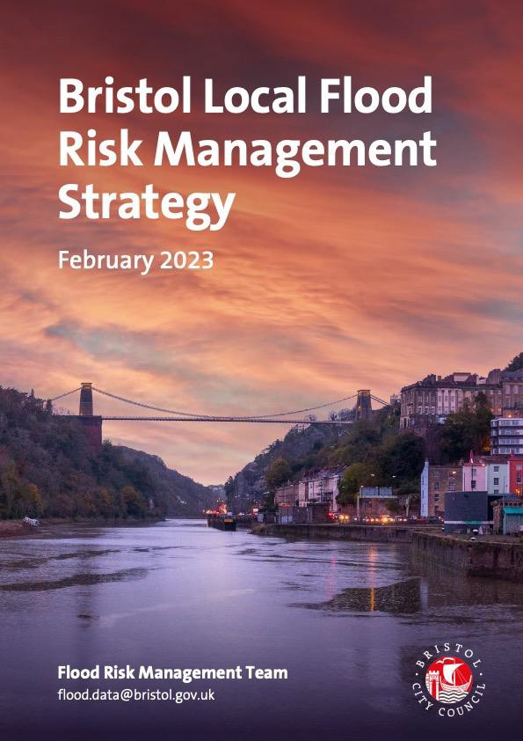
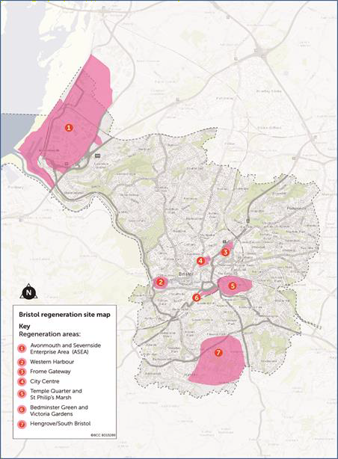
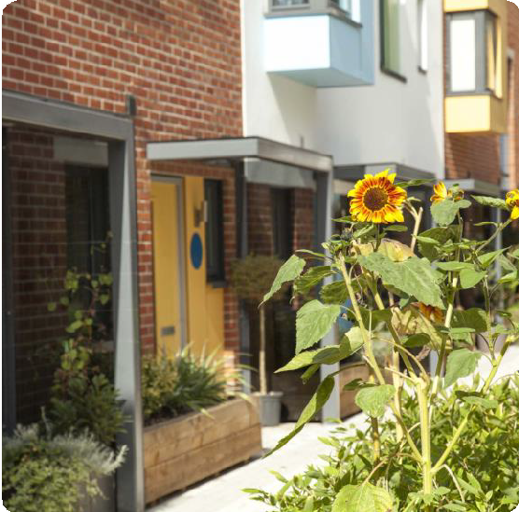
Bristol Local Plan Review
Draft Policies and Development Allocations
Further consultation - November 2022

Slide 8
Unlocking £1bn of investment
towards delivery of net zero goals
Supporting delivery of heat
networks and retrofitting
Creating 1000 new jobs and supporting skills development
Creating further social value –
community impact fund

Slide 9
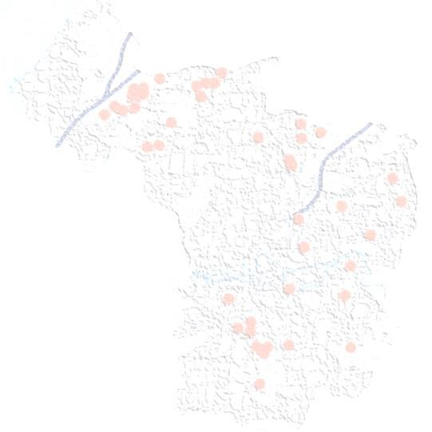
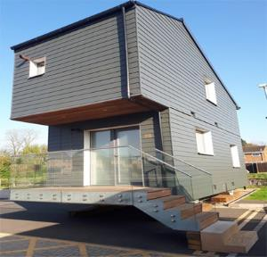
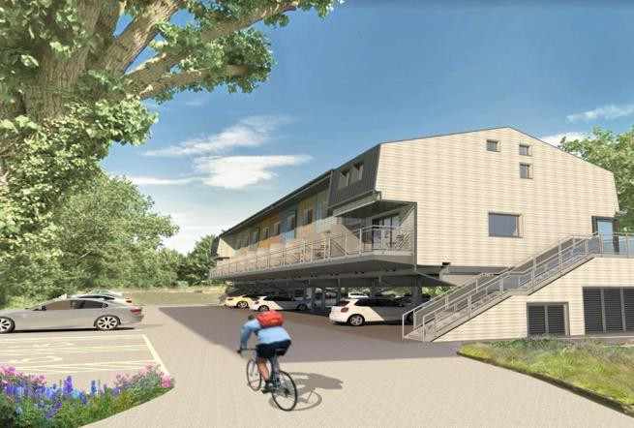
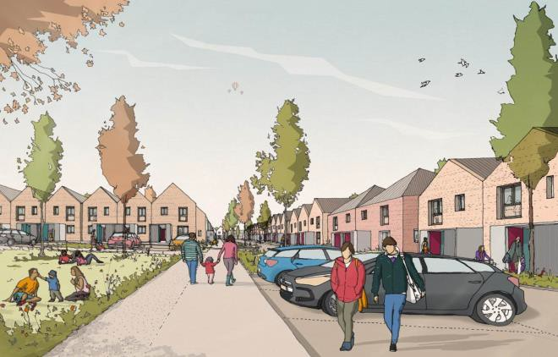
Housing Innovation
Accelerated house building programme: 7,000 homes (1,000 affordable) already built by developers, registered providers and council since 2016
Delivering homes through the HRA New Development Programme and Goram Homes, our Housing Company
Looking for partners and innovative approaches to build 5,000 homes in next 10-15 years - £1bn opportunity
Zero Carbon retrofitting: Investment in Council Housing to achieve zero carbon / increase energy efficiency / reduce fuel poverty

Slide 10
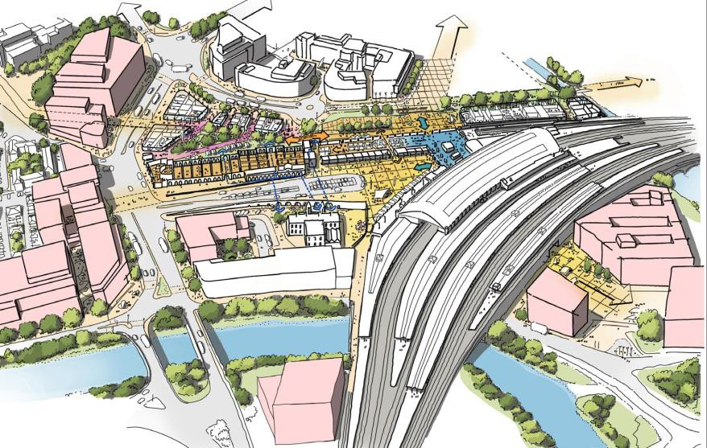
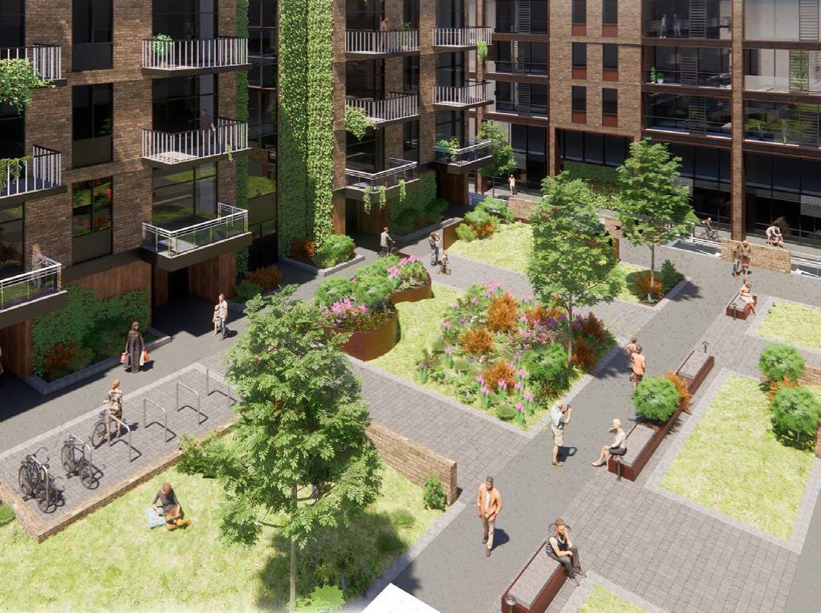
Temple Quarter & St Philip’s Marsh
One of UK’s largest regeneration sites - building on successful Enterprise Zone, innovation & research focus
Transformation of Temple Meads station underway - improving connectivity to London and rest of UK, increasing passenger capacity and footfall
New University of Bristol TQ Enterprise Campus
10,000 new homes
22,000 new jobs

Slide 11
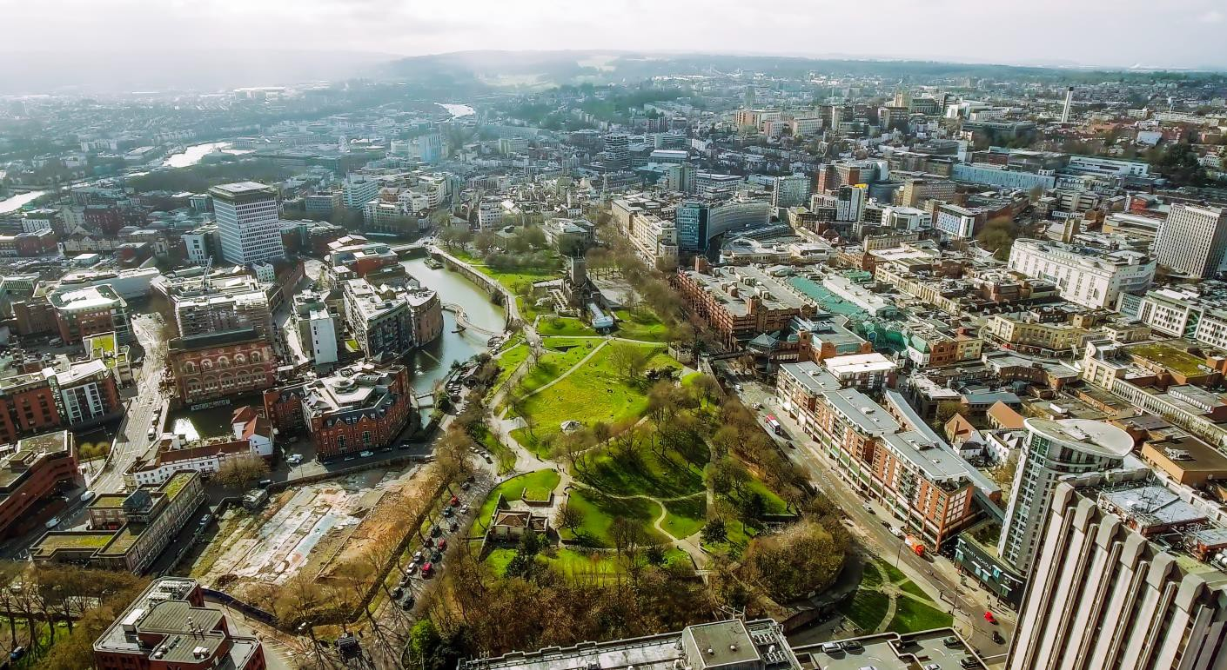
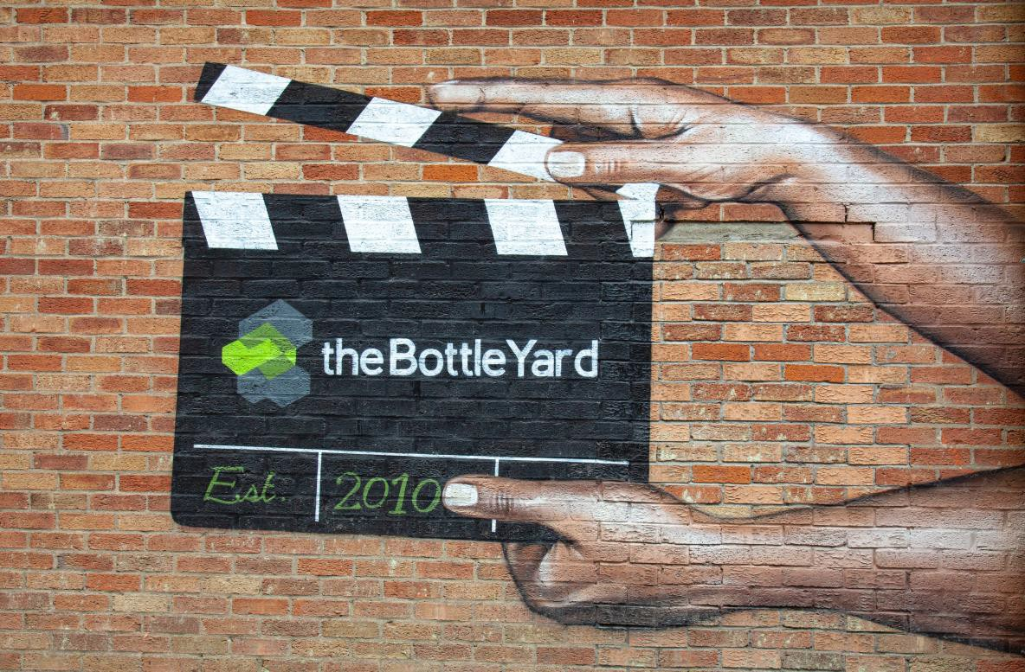
Renewing the City Centre
…… and south Bristol

Slide 12
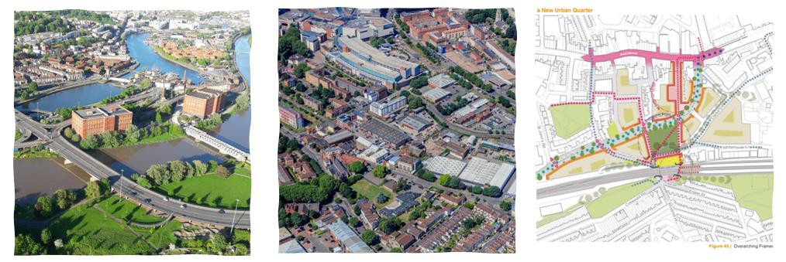
Opportunity Areas
Western Harbour
Frome Gateway
Whitehouse Street

Slide 13
Industrial intensification and co-location

Slide 14
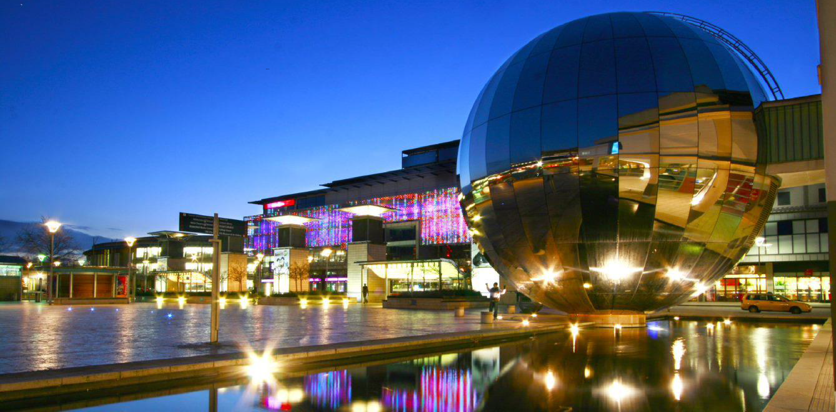
Thank you
For further information please email us:
John.Smith2@bristol.gov.uk

